Slide 1
Exam 4: Bodies
Chapters 9, 10, & 11
Rotation, Equilibrium, Stress & Strain

Slide 2
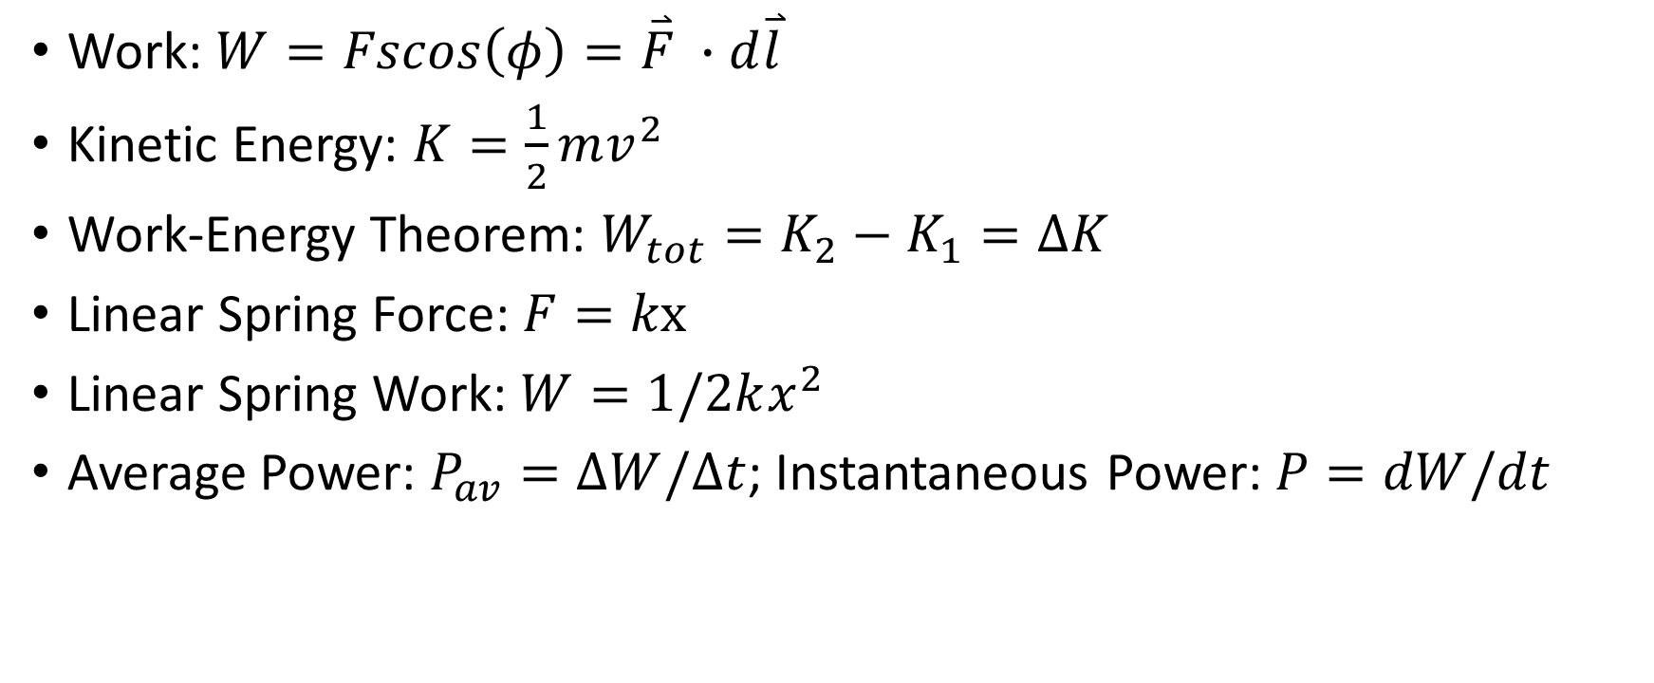
Chapter 9 – Angular Coordinates
Work: $W=Fscos\left(φ\right)=\overset{⃑}{F} ∙d\overset{⃑}{l}$
Kinetic Energy: $K=\frac{1}{2}mv^{2}$
Work-Energy Theorem: $W_{tot}=K_{2}−K_{1}=ΔK$
Linear Spring Force: $F=kx$
Linear Spring Work: $W=1/2kx^{2}$
Average Power: $P_{av}=ΔW/Δt$; Instantaneous Power: $P=dW/dt$

Slide 3
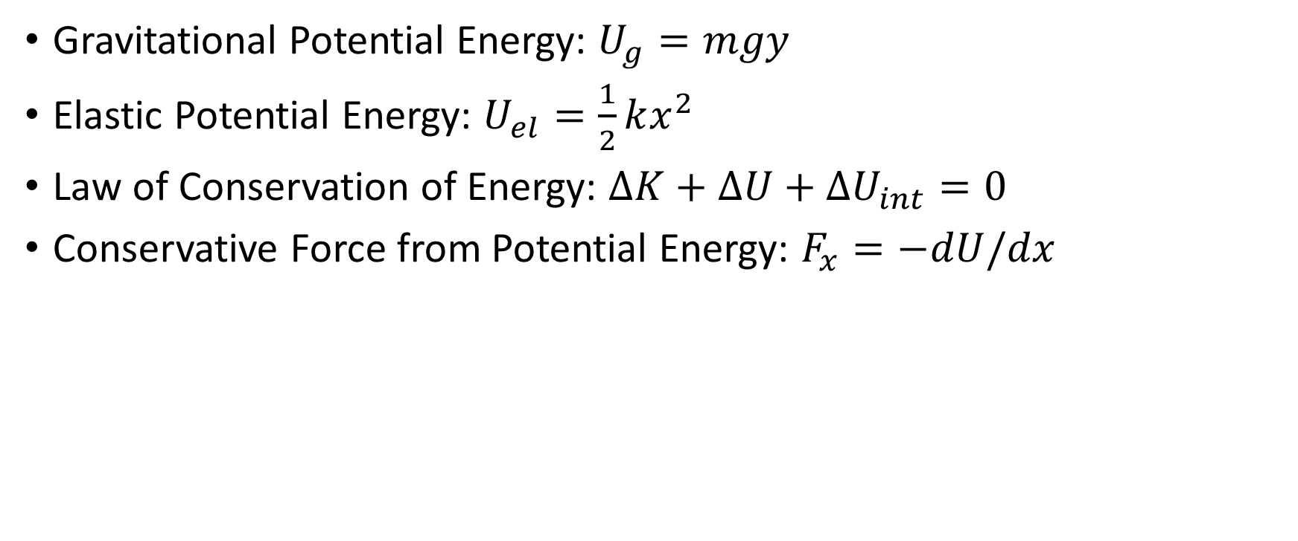
Chapter 7
Gravitational Potential Energy: $U_{g}=mgy$
Elastic Potential Energy: $U_{el}=\frac{1}{2}kx^{2}$
Law of Conservation of Energy: $ΔK+ΔU+ΔU_{int}=0$
Conservative Force from Potential Energy: $F_{x}=−dU/dx$

Slide 4
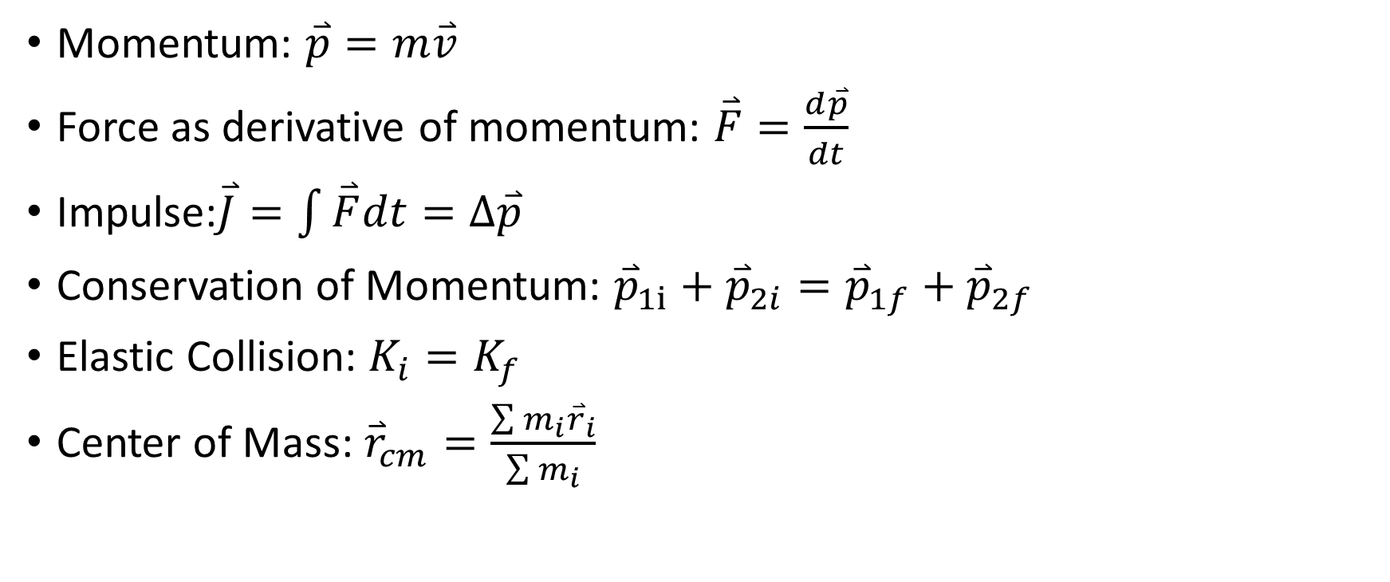
Chapter 8
Momentum: $\overset{⃑}{p}=m\overset{⃑}{v}$
Force as derivative of momentum: $\overset{⃑}{F}=\frac{d\overset{⃑}{p}}{dt}$
Impulse:$\overset{⃑}{J}=\int{\overset{⃑}{F}dt}=Δ\overset{⃑}{p}$
Conservation of Momentum: ${\overset{⃑}{p}}_{1i}+{\overset{⃑}{p}}_{2i}={\overset{⃑}{p}}_{1f}+{\overset{⃑}{p}}_{2f}$
Elastic Collision: $K_{i}=K_{f}$
Center of Mass: ${\overset{⃑}{r}}_{cm}=\frac{\sum{m_{i}{\overset{⃑}{r}}_{i}}}{\sum{m_{i}}}$

Slide 5
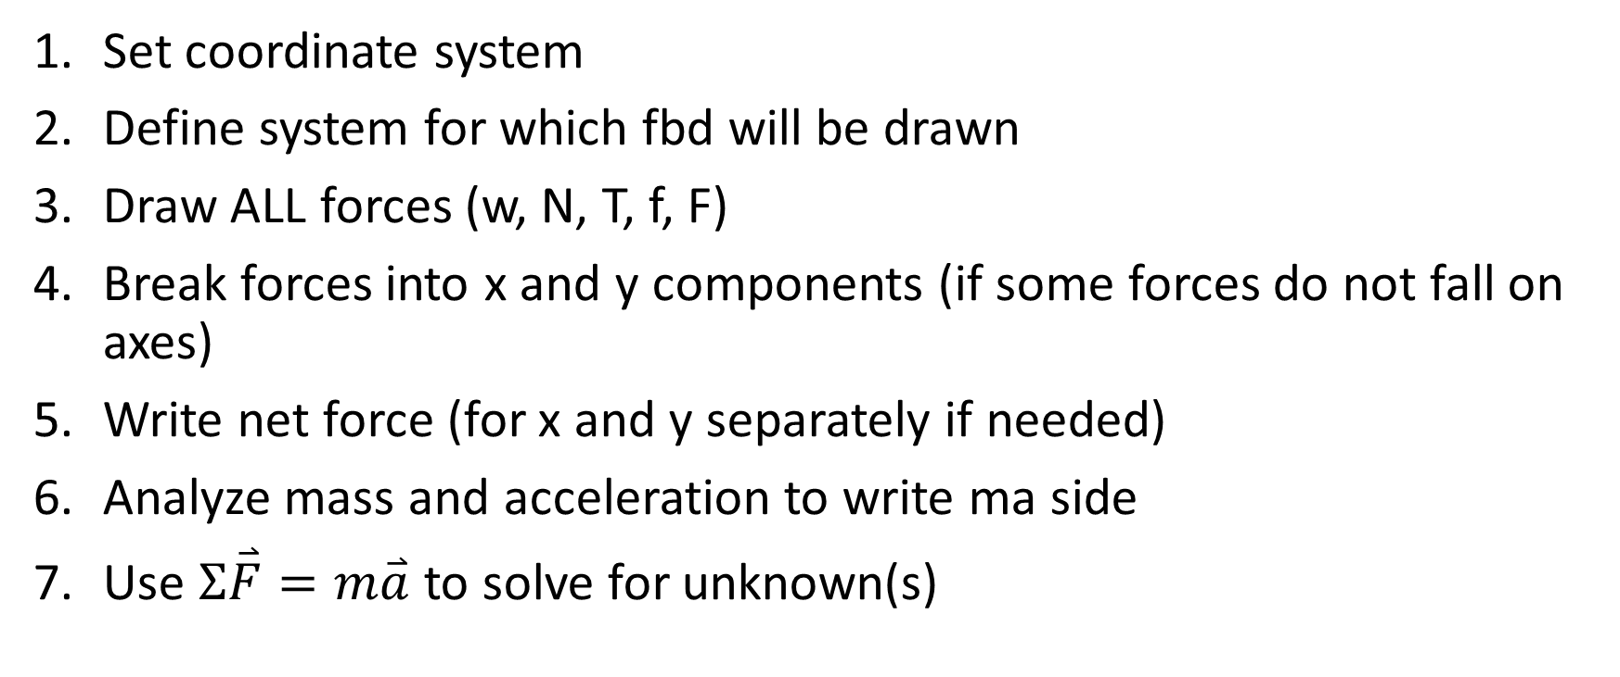
Analyzing forces & drawing free body diagrams
Set coordinate system
Define system for which fbd will be drawn
Draw ALL forces (w, N, T, f, F)
Break forces into x and y components (if some forces do not fall on axes)
Write net force (for x and y separately if needed)
Analyze mass and acceleration to write ma side
Use $Σ\overset{⃑}{F}=m\overset{⃑}{a}$ to solve for unknown(s)

Slide 6
Two dogs pull a sled. One exerts a constant force of 50 N at an angle 30 degrees to the right of north. The other exerts a constant force of 50 N at an angle of 30 degrees to the left of north. What is the total work they do on the sled over a distance of 10 m?
866 J

Slide 7
A 15 N ball is thrown vertically upwards. When it is 7 m above the initial position, its velocity is 5 m/s upwards. Find the ball’s speed when it left its initial position and its maximum height.
ANS

Slide 8
A 5 kg package slides up a 10 m ramp at an angle of 20 degrees above the horizontal. The coefficient of friction between the package and the ramp is 0.1. If the package reaches the top of the ramp with a speed of 1 m/s, determine its speed at the bottom of the ramp using energy analysis.
9.3 m/s

Slide 9
A 0.7 kg block is loaded in a vertical spring with constant k = 85,000 N/m compressed by 3 cm. When the spring and block are released, determine the maximum height attained by the block.
ANS

Slide 10
A 16 kg block slides on a rough horizontal surface before coming to rest. If the initial speed of the block is 18 m/s and the coefficient of friction between the block and the surface is 0.75, find the average power produced by the friction as the block stops.
-1060 W

Slide 11
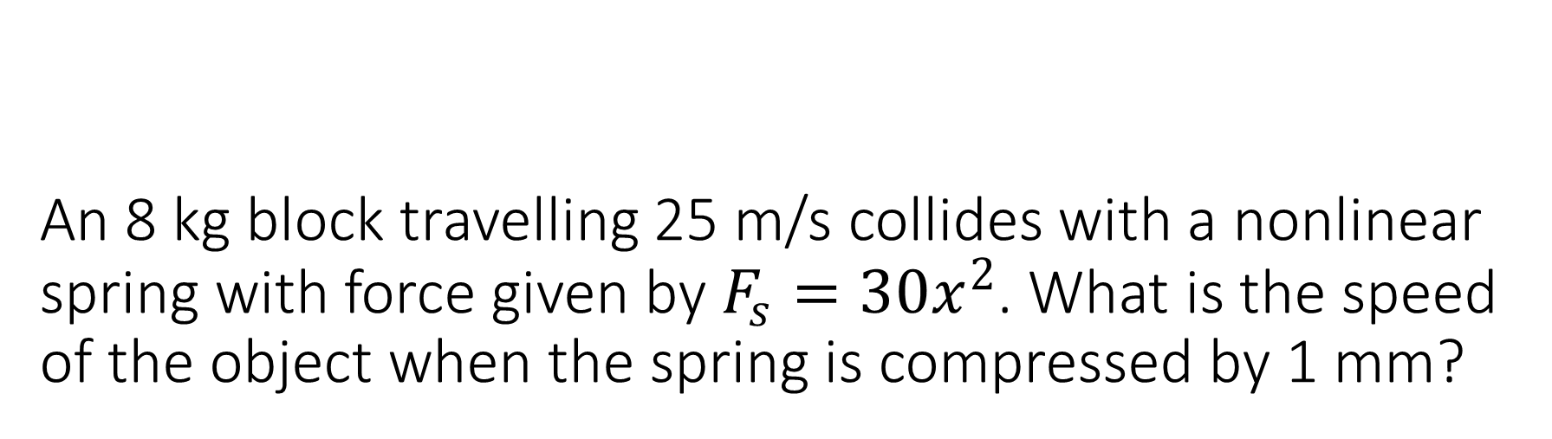
An 8 kg block travelling 25 m/s collides with a nonlinear spring with force given by $F_{s}=30x^{2}$. What is the speed of the object when the spring is compressed by 1 mm?
ANS

Slide 12
Block of mass 10 kg (starting from rest) slides down the ramp inclined at an angle θ above horizontal. Block moves the distance 7 m along the ramp before encountering a spring with force constant 1200 N/m compressing it by 35 cm. (a) Find the angle θ if the ramp is frictionless.
5.9 degrees

Slide 13
A 1.5 kg block is connected to two ideal horizontal springs having force constants k1=30 N/cm and k2=32 N/cm. The block is pushed 20 cm to the right and released from rest. What is the maximum speed of the block and what is the maximum compression of spring 1?
ANS

Slide 14
A 25 kg rock approaches the foot of a hill with a speed of 17 m/s. This hill slopes upward at a constant angle of 35 degrees above the horizontal. The coefficient of kinetic friction is 0.19. Find the maximum height reached by the rock, and the rock’s speed at the bottom of the hill on the way back down.
11.6 m

Slide 15
In a 2-dimensional system, A 0.75 kg basketball strikes the backboard while travelling at an angle of 45 degrees above the horizontal with a speed of 20 m/s, and it leaves the backboard travelling horizontally with a speed of 15 m/s. If the ball and backboard are in contact for 1.25 ms, find the horizontal and vertical components of the average net force acting on the ball.
18000 N, -8500 N

Slide 16
Two billiard balls of equal mass collide on a pool table. Ball A which was initially travelling at 2 m/s, is deflected 20 degrees from its original direction. Ball B was originally at rest, and travels 60 degrees from the original direction of A. Find the speed of each ball after the collision and find the fraction of the kinetic energy dissipated during the collision.
1.8, 0.69; 7%

Slide 17
A 20 kg block is attached to a light horizontal spring of k=500 N/m and is resting on a table with coefficient of friction 0.2. The block is struck by a 2 kg projectile travelling horizontally at 25 m/s. Find how far the block travels if (a) the projectile rebounds with a speed of 8 m/s or if (b) the projectile remains embedded in the block.
ANS

Slide 18
A 120 kg bighorn sheep and a 150 kg bighorn sheep are fighting on a horizontal muddy surface. The two sheep collide at right angles and slide as one through the mud. The coefficient of kinetic friction between their hooves and the ground is 0.15. If the sheep come to rest at a point 5.5 m from where they collided at an angle of 20 degrees from the heavier sheep’s original direction of motion, how fast was each sheep travelling?
Heavier: 6.8 m/s, Lighter: 3.1 m/s

Slide 19
An 8 kg ball is hanging from the ceiling by a light string 120 cm long. If the ball is struck by a 2 kg ball moving 7 m/s horizontally in a perfectly elastic collision, find (a) the velocity of each ball after and (b) the tension of the string just after the collision.
2.8 m/s, -4.2 m/s;
130 N

